Slide 1
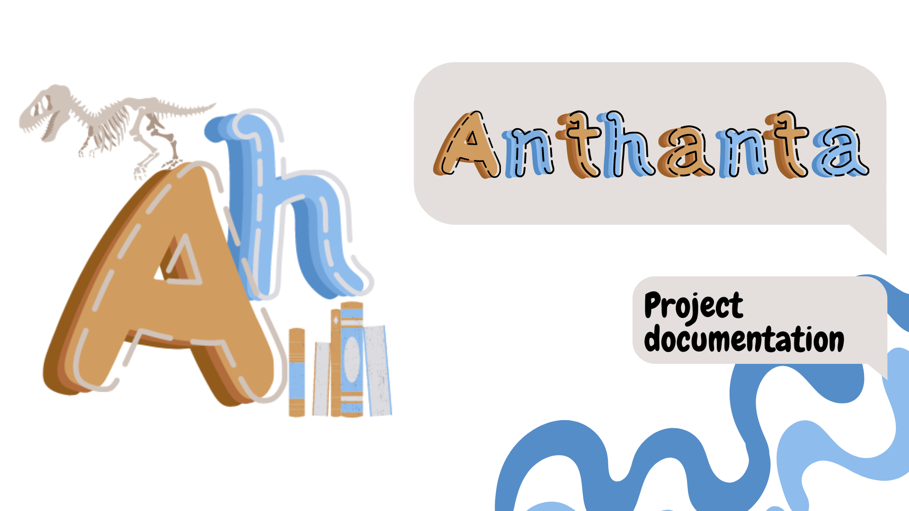


Slide 2

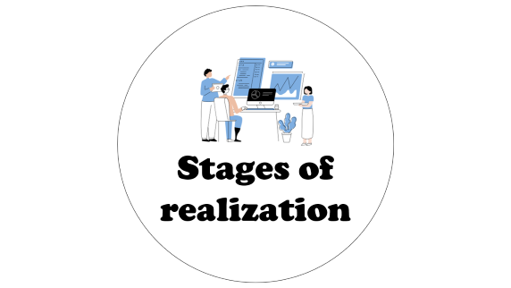





Table of contents

Slide 3

Our team

Slide 4

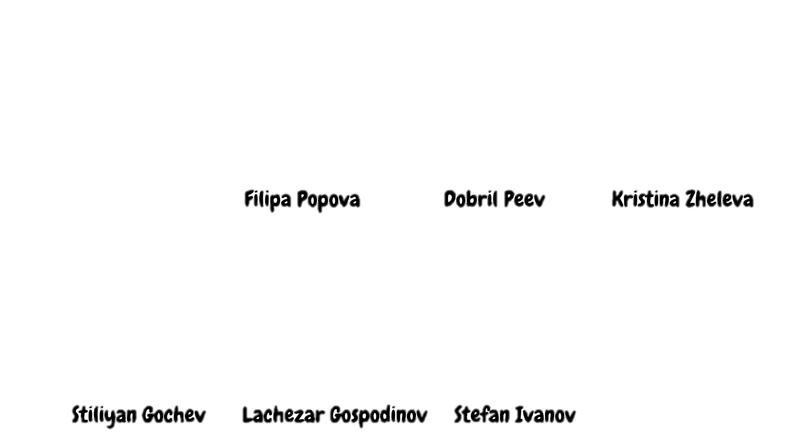
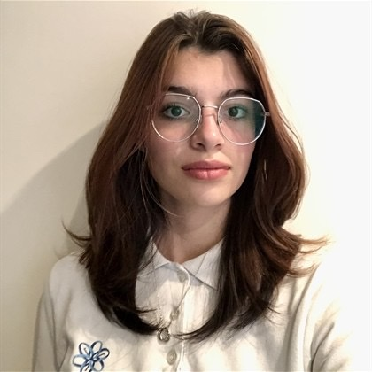
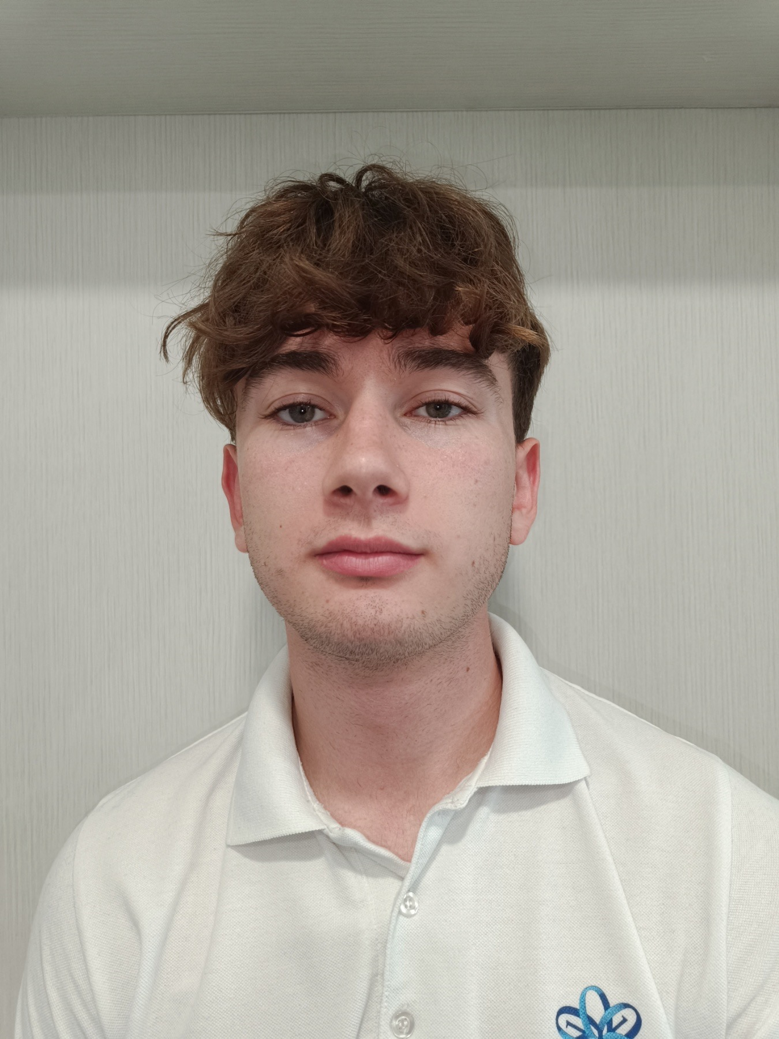
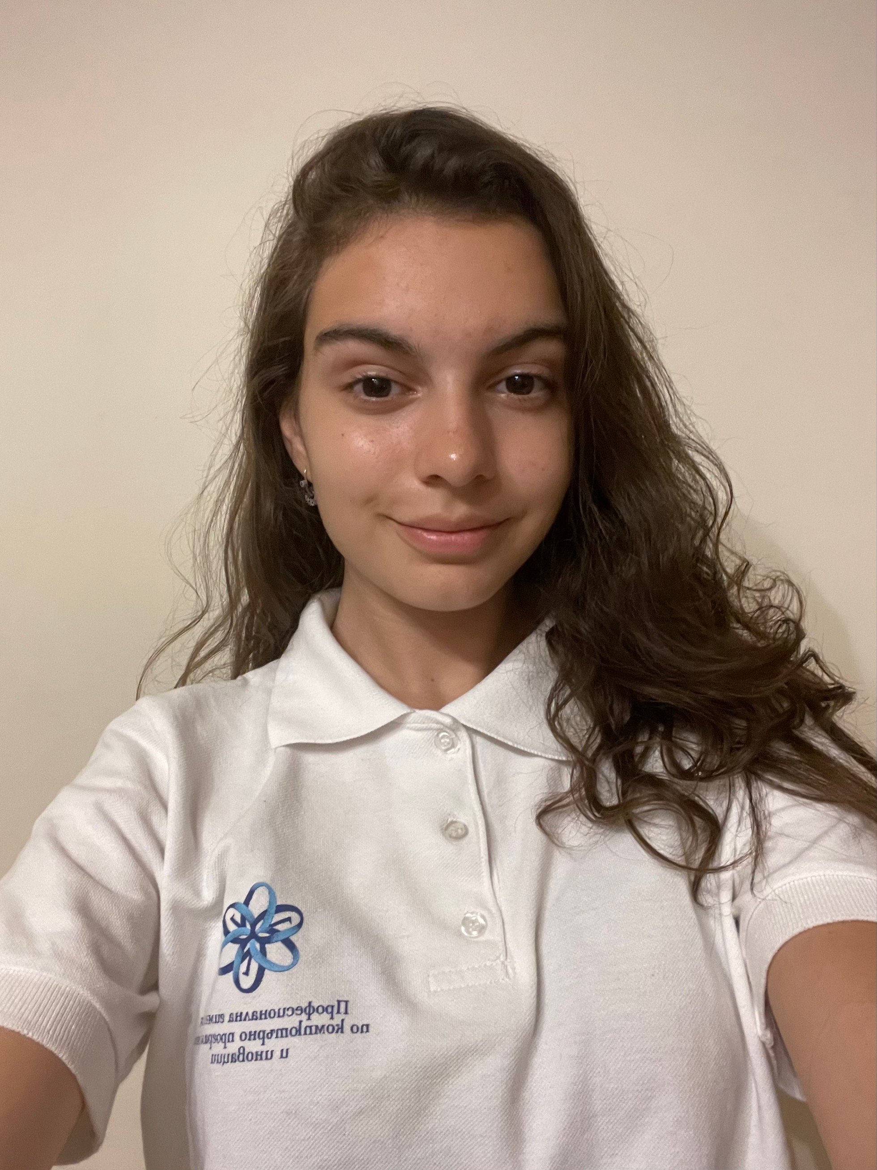
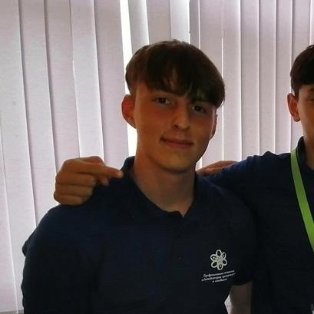
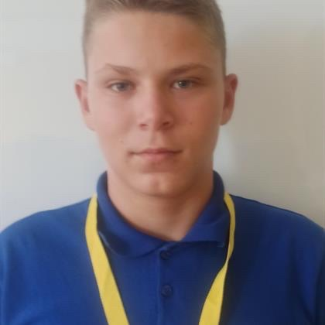
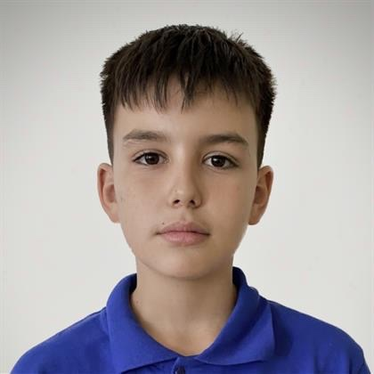
Our Team

Slide 5

Idea

Slide 6

Our application aims to support the development of knowledge in the field of History, through short and easy questions, following the world and Bulgarian past.

Slide 7
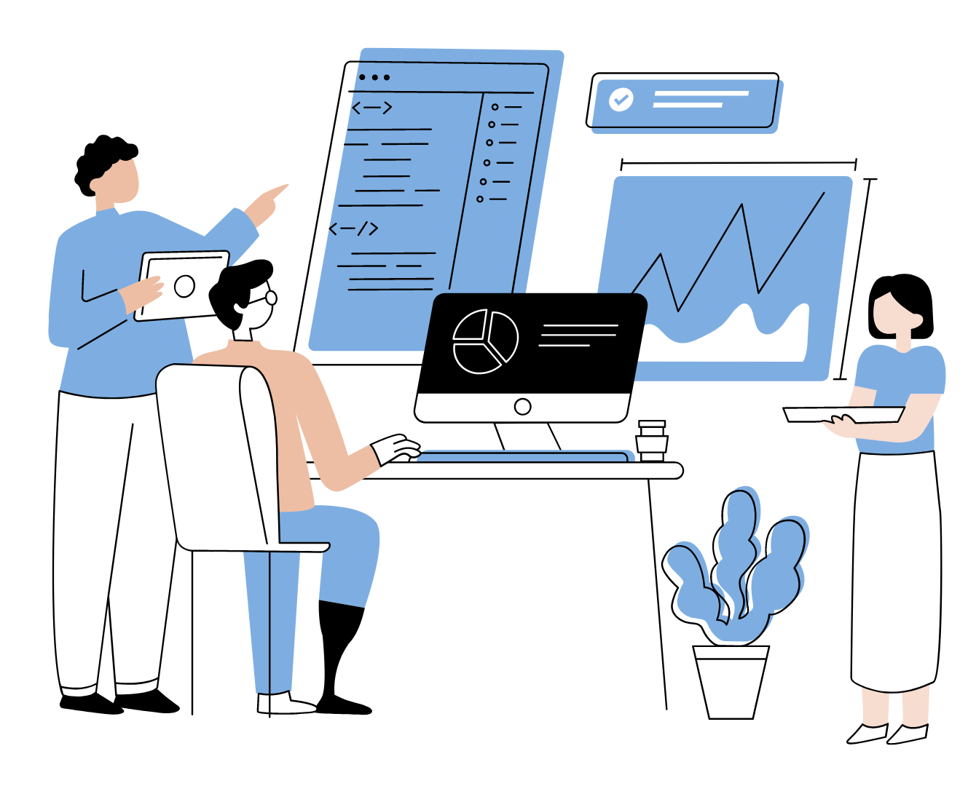
Stages of realization

Slide 8
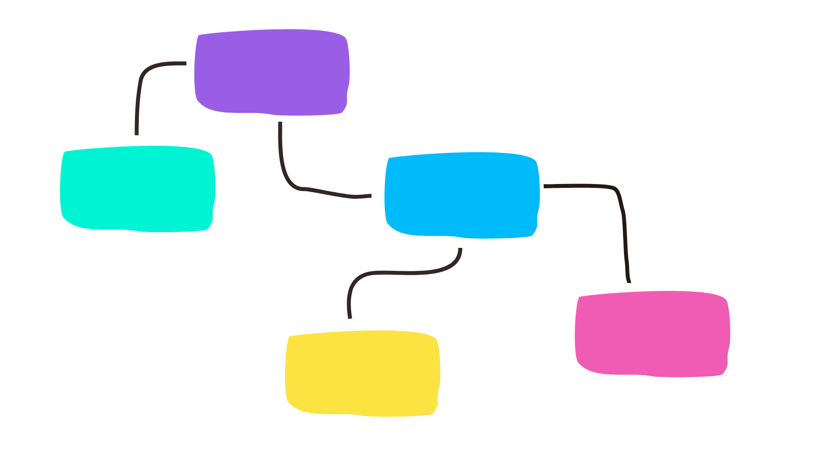

Stages
of realization
Come up with the idea
Form a team
Work on code
Present the project
Finish the app

Slide 9

Used programs

Slide 10










Used programs

Slide 11
Now, it is time to see the app...

